Slide 1
Regression 1: OLS Fundamentals
UIUC ECON 474 Econometrics of Policy Evaluation

Slide 2
Overview
Next time: watch (on double speed?)
Logistic Regression Details Pt1: Coefficients
Logistic Regression Details Pt2: Maximum Likelihood
Today (non-causal):
OLS identifying assumptions
OLS practical considerations
OLS extensions relevant for econometrics

Slide 3
OLS Basics
Assumptions required to analyze relationships in data

Slide 4
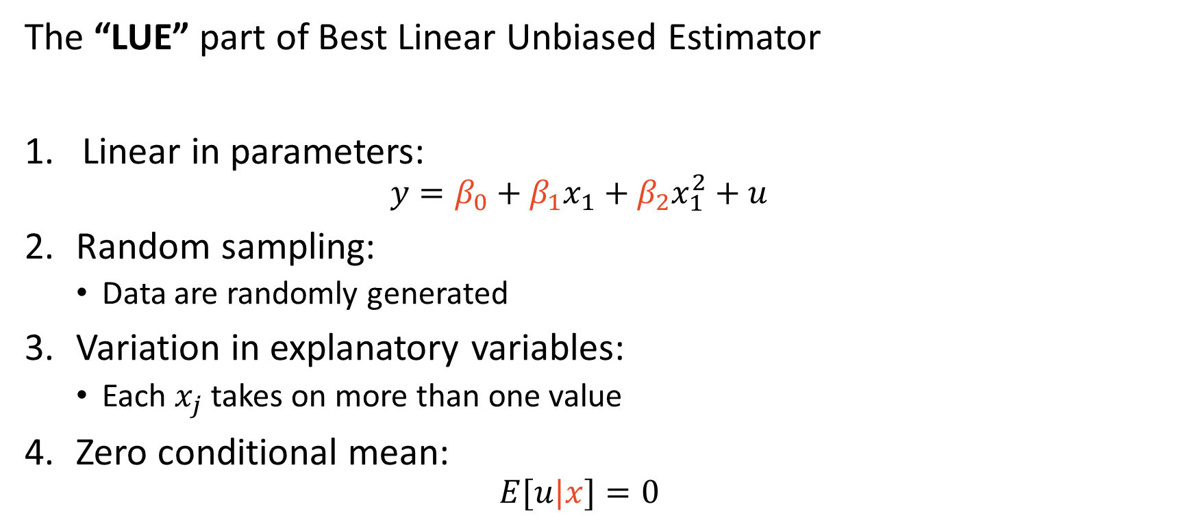
OLS assumptions à la Scott Cunningham
The “LUE” part of Best Linear Unbiased Estimator
Linear in parameters:
$$y=β_{0}+β_{1}x_{1}+β_{2}x_{1}^{2}+u$$
Random sampling:
Data are randomly generated
Variation in explanatory variables:
Each $x_{j}$ takes on more than one value
Zero conditional mean:
$$E[u|x]=0$$

Slide 5
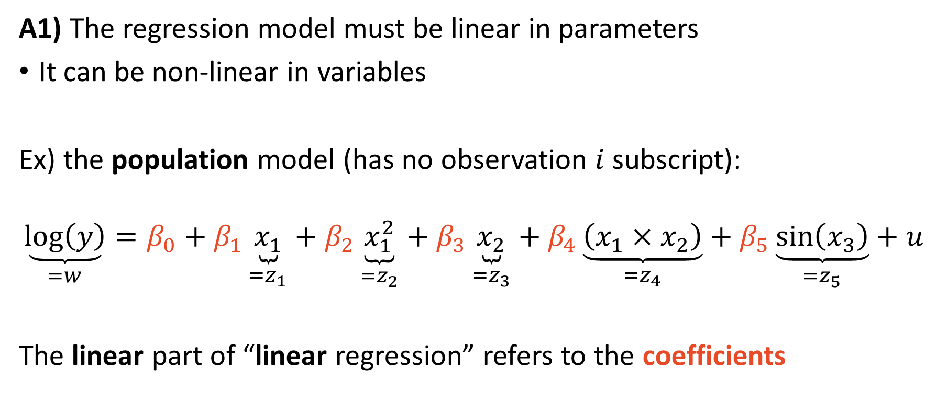
Variables may be non-linear
A1) The regression model must be linear in parameters
It can be non-linear in variables
Ex) the population model (has no observation $i$ subscript):
$$\underset{=w}{\underbrace{\log\left(y\right)}}=β_{0}+β_{1}\underset{{=z}_{1}}{\underbrace{x_{1}}}+β_{2}\underset{=z_{2}}{\underbrace{x_{1}^{2}}}+β_{3}\underset{{=z}_{3}}{\underbrace{x_{2}}}+β_{4}\underset{=z_{4}}{\underbrace{\left(x_{1}×x_{2}\right)}}+β_{5}\underset{{=z}_{5}}{\underbrace{\sin\left(x_{3}\right)}}+u$$
The linear part of “linear regression” refers to the coefficients

Slide 6
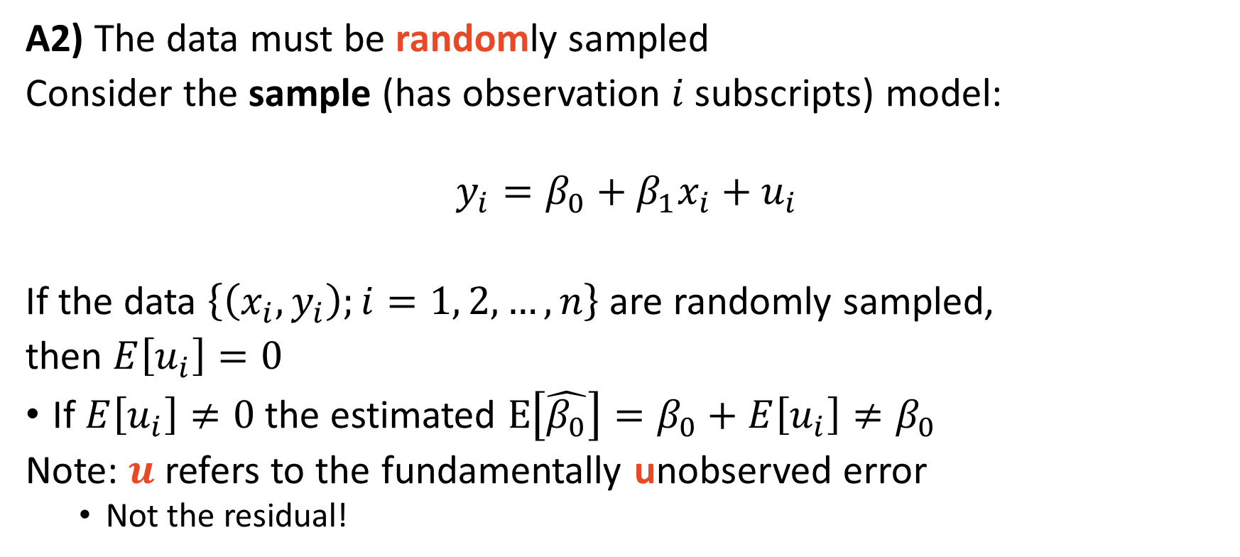
Random data permits coefficient estimation
A2) The data must be randomly sampled
Consider the sample (has observation $i$ subscripts) model:
$$y_{i}=β_{0}+β_{1}x_{i}+u_{i}$$
If the data $\left\{\left(x_{i},y_{i}\right);i=1, 2, …, n\right\}$ are randomly sampled,
then $E\left[u_{i}\right]=0$
If $E\left[u_{i}\right]≠0$ the estimated $E\left[\hat{β_{0}}\right]=β_{0}+$ $E\left[u_{i}\right]≠β_{0}$
Note: $u$ refers to the fundamentally unobserved error
Not the residual!

Slide 7
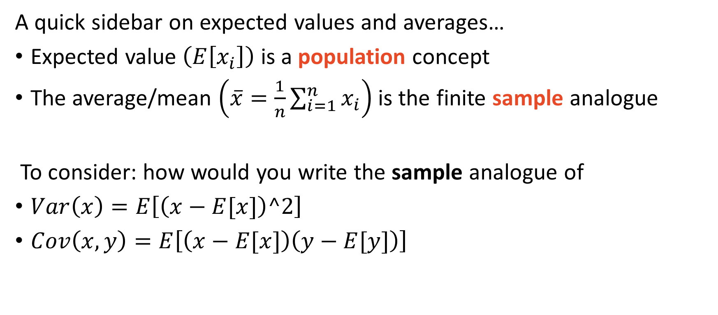
Expected value and average are the same concept
A quick sidebar on expected values and averages…
Expected value $\left(E\left[x_{i}\right]\right)$ is a population concept
The average/mean $\left(\overline{x}=\frac{1}{n}\sum_{i=1}^{n}{x_{i}}\right)$ is the finite sample analogue
To consider: how would you write the sample analogue of
$Var\left(x\right)=E\left[\left(x−E[x]\right)^2\right]$
$Cov\left(x,y\right)=E\left[\left(x−E[x]\right)\left(y−E[y]\right)\right]$

Slide 8
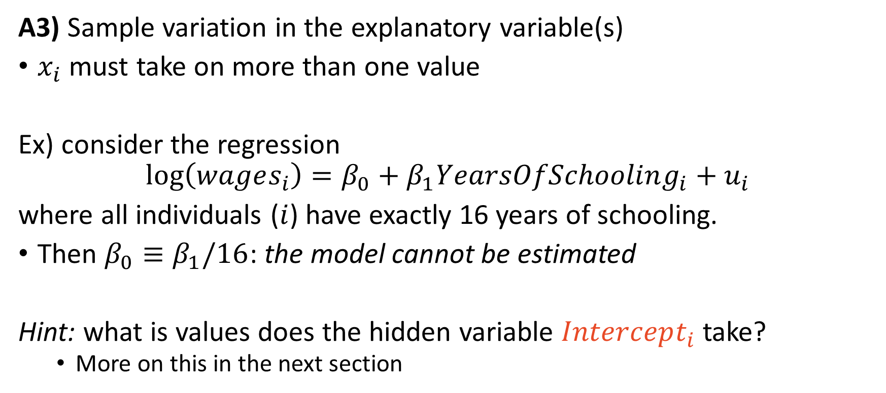
The model (b/c of intercept $β_{0}$) can be estimated
A3) Sample variation in the explanatory variable(s)
$x_{i}$ must take on more than one value
Ex) consider the regression
$$\log\left(wages_{i}\right)=β_{0}+β_{1}YearsOfSchooling_{i}+u_{i}$$
where all individuals ($i$) have exactly 16 years of schooling.
Then $β_{0}≡β_{1}/16$: the model cannot be estimated
Hint: what is values does the hidden variable $Intercept_{i}$ take?
More on this in the next section

Slide 9
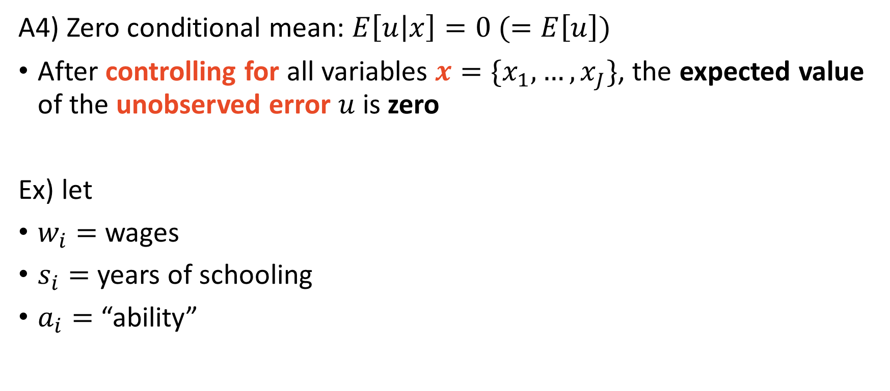
Zero conditional (on control variables) mean
A4) Zero conditional mean: $E\left[u | x\right]=0 (=E\left[u\right])$
After controlling for all variables $x=\{x_{1},…,x_{J}\}$, the expected value of the unobserved error $u$ is zero
Ex) let
$w_{i}=$ wages
$s_{i}=$ years of schooling
$a_{i}=$ “ability”

Slide 10
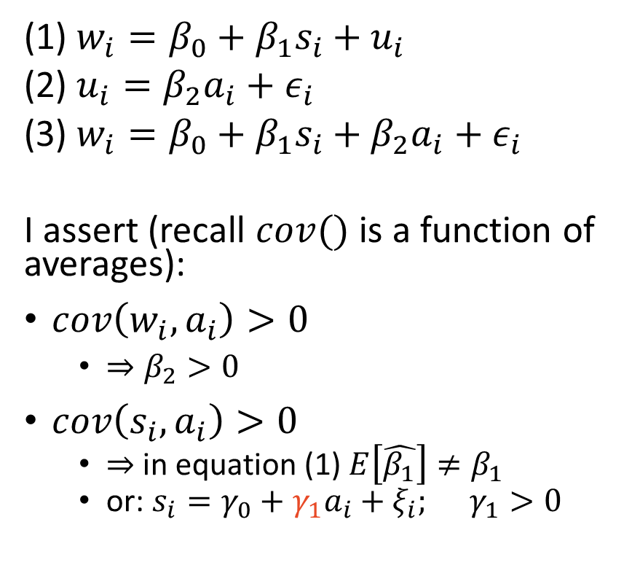
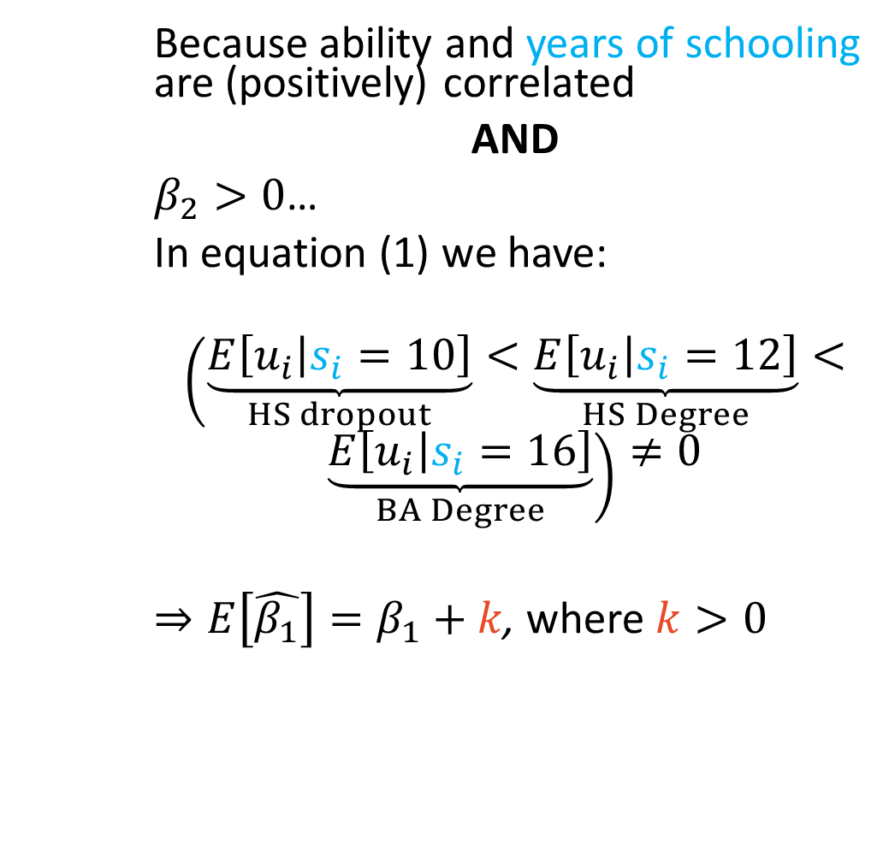
A4) All coefficients $(β_{0},β_{1},…)$ are unbiased
(1) $w_{i}=β_{0}+β_{1}s_{i}+u_{i}$
(2) $u_{i}=β_{2}a_{i}+ε_{i}$
(3) $w_{i}=β_{0}+β_{1}s_{i}+β_{2}a_{i}+ε_{i}$
I assert (recall $cov()$ is a function of averages):
$cov\left(w_{i},a_{i}\right)>0$
$⇒β_{2}>0$
$cov\left(s_{i},a_{i}\right)>0$
$⇒$ in equation (1) $E\left[\hat{β_{1}}\right]≠β_{1}$
or: $s_{i}=γ_{0}+γ_{1}a_{i}+ξ_{i}; γ_{1}>0$
Because ability and years of schooling are (positively) correlated
AND
$β_{2}>0$…
In equation (1) we have:
$$\left(\underset{HS dropout}{\underbrace{E\left[u_{i} | s_{i}=10\right]}}<\underset{HS Degree}{\underbrace{E\left[u_{i} | s_{i}=12\right]}}<\right.$$
$$\left.\underset{BA Degree}{\underbrace{E\left[u_{i} | s_{i}=16\right]}}\right)≠0$$
$⇒E\left[\hat{β_{1}}\right]=β_{1}+k$, where $k>0$

Slide 11
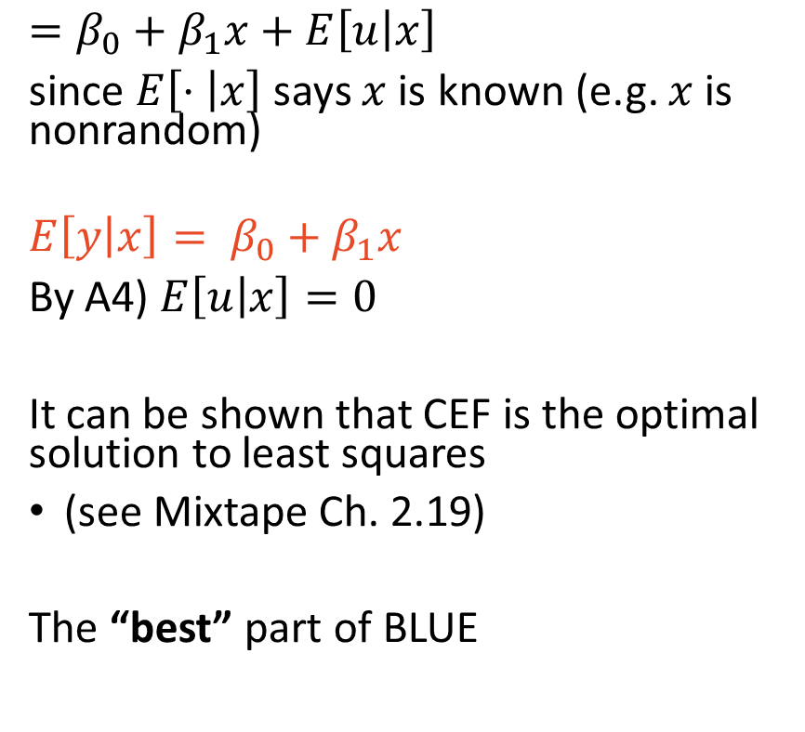
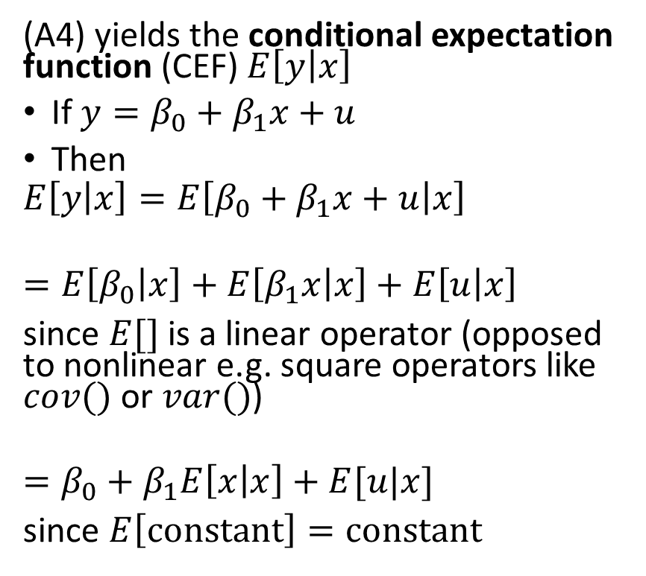
Regression is the CEF, which is optimal for least squares
(A4) yields the conditional expectation function (CEF) $E\left[y | x\right]$
If$y=β_{0}+β_{1}x+u$
Then
$$E\left[y | x\right]=E\left[β_{0}+β_{1}x+u | x\right]$$
$$=E\left[β_{0} | x\right]+E\left[β_{1}x | x\right]+E\left[u | x\right]$$
since $E[]$ is a linear operator (opposed to nonlinear e.g. square operators like $cov()$ or $var()$)
$$=β_{0}+β_{1}E\left[x | x\right]+E[u|x]$$
since $E\left[constant\right]=constant$
$$=β_{0}+β_{1}x+E\left[u | x\right]$$
since $E\left[⋅ | x\right]$ says $x$ is known (e.g. $x$ is nonrandom)
$$E\left[y | x\right]= β_{0}+β_{1}x$$
By A4) $E\left[u | x\right]=0$
It can be shown that CEF is the optimal solution to least squares
(see Mixtape Ch. 2.19)
The “best” part of BLUE

Slide 12
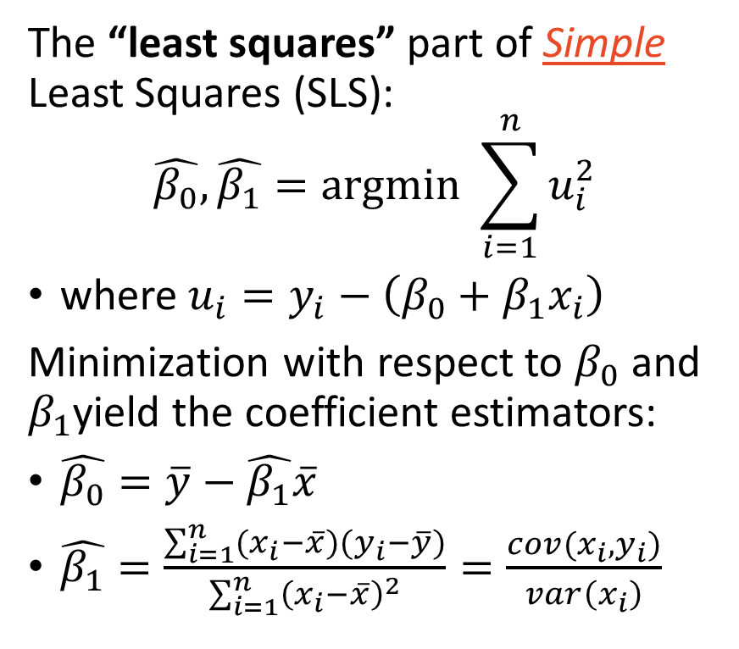
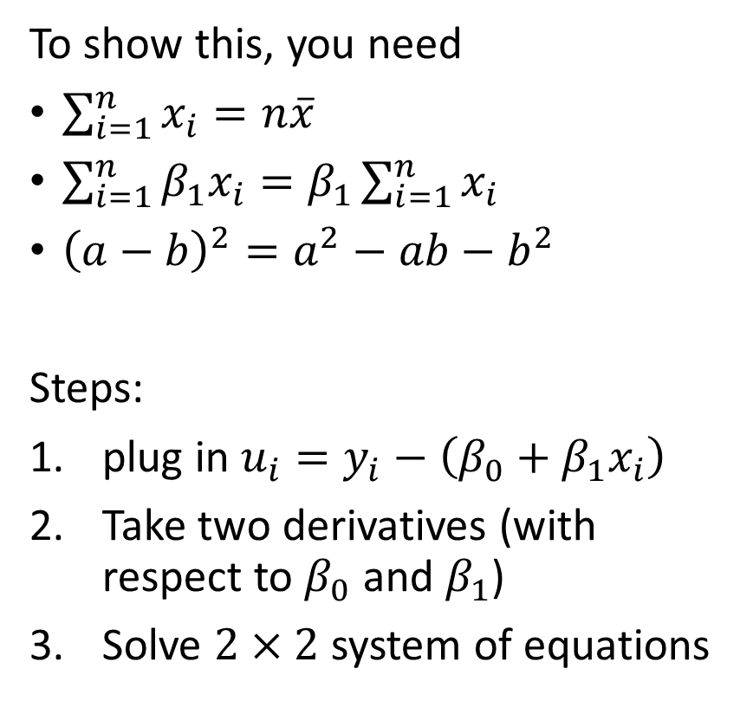
How to obtain coefficient estimators $\hat{β_{0}}$ and $\hat{β_{1}}$
The “least squares” part of Simple Least Squares (SLS):
$$\hat{β_{0}},\hat{β_{1}}=argmin \sum_{i=1}^{n}{u_{i}^{2}}$$
where $u_{i}=y_{i}−\left(β_{0}+β_{1}x_{i}\right)$
Minimization with respect to $β_{0}$ and $β_{1}$yield the coefficient estimators:
$\hat{β_{0}}=\overline{y}−\hat{β_{1}}\overline{x}$
$\hat{β_{1}}=\frac{\sum_{i=1}^{n}{(x_{i}−\overline{x})(y_{i}−\overline{y})}}{\sum_{i=1}^{n}{{\left(x_{i}−\overline{x}\right)}^{2}}}=\frac{cov(x_{i},y_{i})}{var\left(x_{i}\right)}$
To show this, you need
$\sum_{i=1}^{n}{x_{i}}=n\overline{x}$
$\sum_{i=1}^{n}{{β_{1}x}_{i}}=β_{1}\sum_{i=1}^{n}{x_{i}}$
${\left(a−b\right)}^{2}=a^{2}−ab−b^{2}$
Steps:
plug in $u_{i}=y_{i}−\left(β_{0}+β_{1}x_{i}\right)$
Take two derivatives (with respect to $β_{0}$ and $β_{1}$)
Solve $2×2$ system of equations

Slide 13
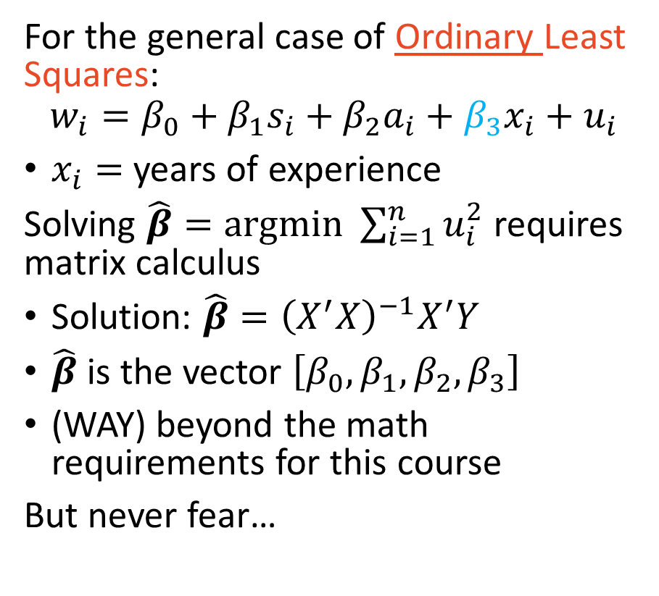
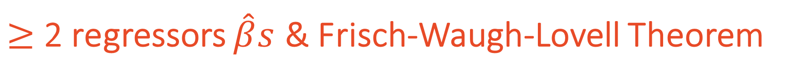
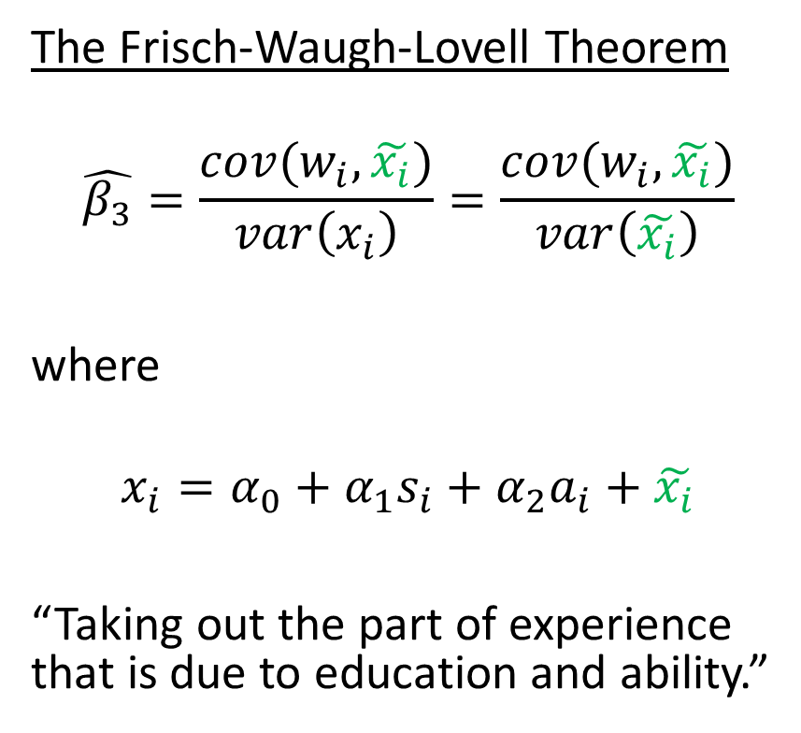
$≥$ 2 regressors $\hat{β}s$ & Frisch-Waugh-Lovell Theorem
For the general case of Ordinary Least Squares:
$$w_{i}=β_{0}+β_{1}s_{i}+β_{2}a_{i}+β_{3}x_{i}+u_{i}$$
$x_{i}=$ years of experience
Solving $\hat{β}=argmin \sum_{i=1}^{n}{u_{i}^{2}}$ requires matrix calculus
Solution: $\hat{β}={\left(X^{′}X\right)}^{−1}X^{′}Y$
$\hat{β}$ is the vector $\left[β_{0}, β_{1}, β_{2},β_{3}\right]$
(WAY) beyond the math requirements for this course
But never fear…
The Frisch-Waugh-Lovell Theorem
$$\hat{β_{3}}=\frac{cov(w_{i},\tilde{x_{i}})}{var\left(x_{i}\right)}=\frac{cov(w_{i},\tilde{x_{i}})}{var\left(\tilde{x_{i}}\right)}$$
where
$$x_{i}=α_{0}+α_{1}s_{i}+α_{2}a_{i}+\tilde{x_{i}}$$
“Taking out the part of experience that is due to education and ability.”

Slide 14
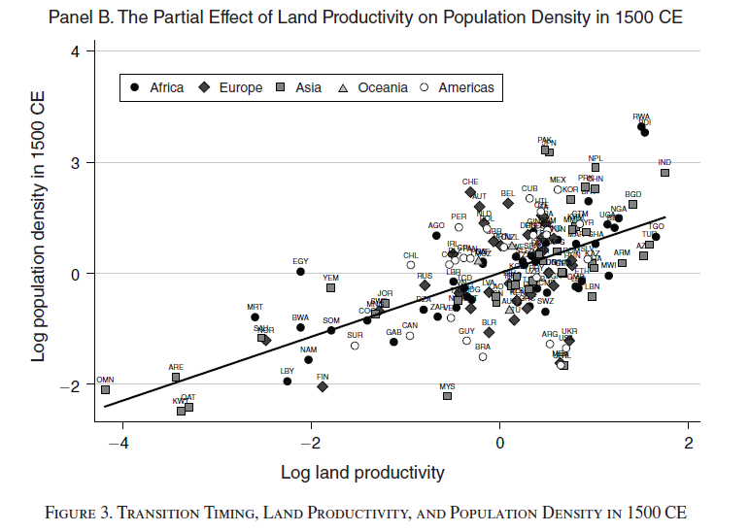
FWL is useful for plotting the coefficient of interest
Source: Ashraf and Galor (2011) Dynamics and Stagnation in the Malthusian Epoch

Slide 15

“Okay, so there is a bunch of math to solve for coefficients using ordinary least squares. What is actually doing?

Slide 16

“Great question! Let’s show it in a gif!”

Slide 17
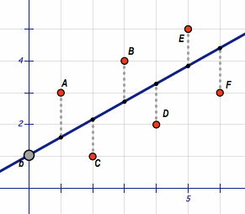
The “least squares” part of Ordinary Least Squares
Source: https://en.wikipedia.org/wiki/File:Least_Squares.gif

Slide 18
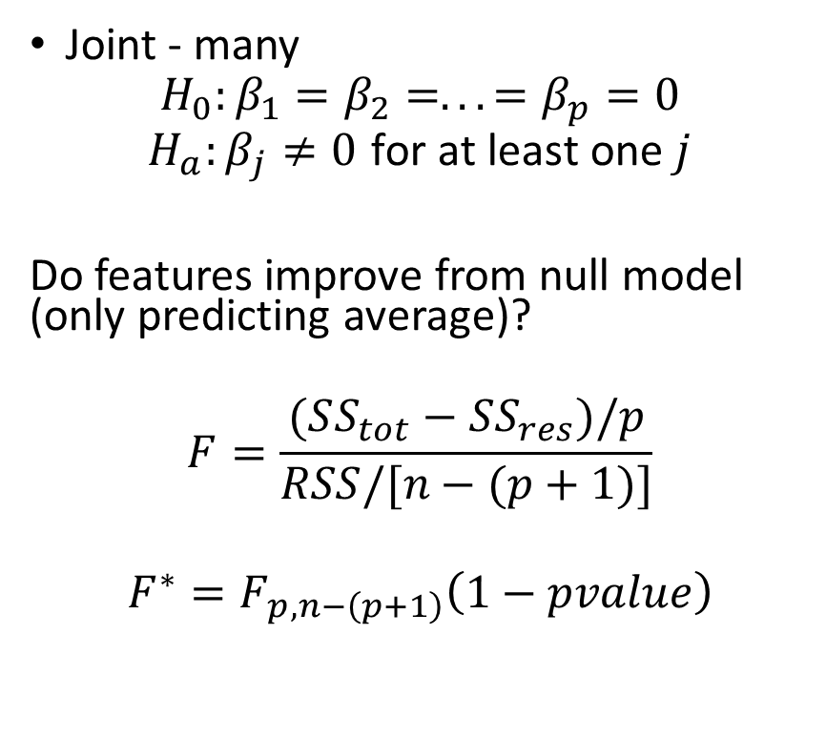
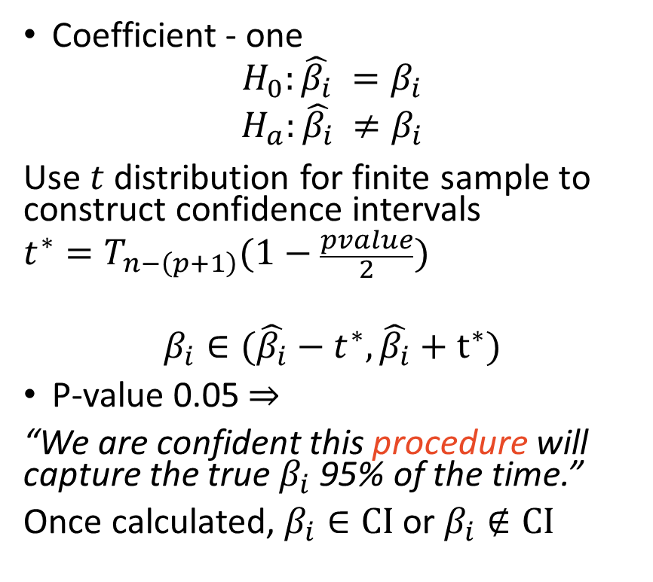
Hypothesis Testing
Coefficient - one
$$H_{0}:{\hat{β_{i}}}_{ }=β_{i}$$
$$H_{a}:{\hat{β_{i}}}_{ }≠β_{i}$$
Use $t$ distribution for finite sample to construct confidence intervals
$$t^{∗}=T_{n−\left(p+1\right)}(1−\frac{pvalue}{2})$$
$$β_{i}∈(\hat{β_{i}}−t^{∗},\hat{β_{i}}+t^{∗})$$
P-value 0.05 $⇒$
“We are confident this procedure will capture the true $β_{i}$ 95% of the time.”
Once calculated, $β_{i}∈CI$ or $β_{i}∉CI$
Joint - many
$$H_{0}:β_{1}=β_{2}=...=β_{p}=0$$
$$H_{a}:β_{j}≠0 \text{for} \text{at} \text{least} \text{one} j$$
Do features improve from null model (only predicting average)?
$$F=\frac{(SS_{tot}−SS_{res})/p}{RSS/[n−(p+1)]}$$
$$F^{∗}=F_{p,n−\left(p+1\right)}\left(1−pvalue\right)$$

Slide 19
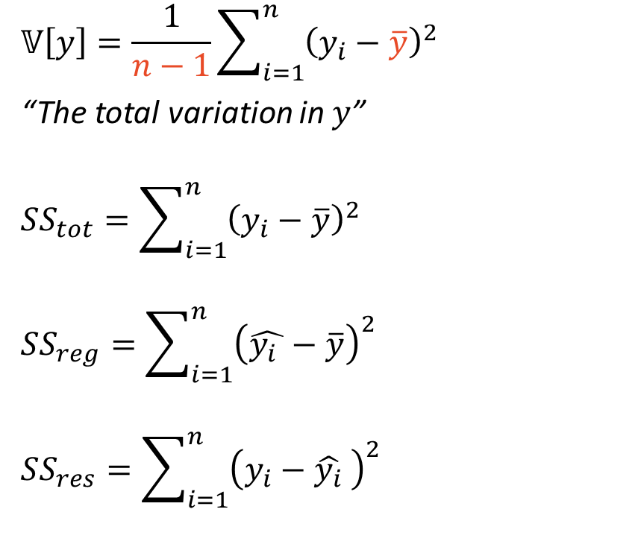
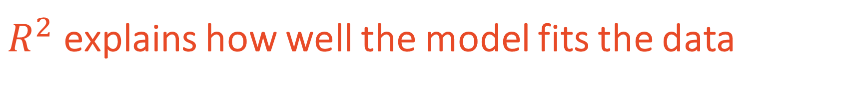
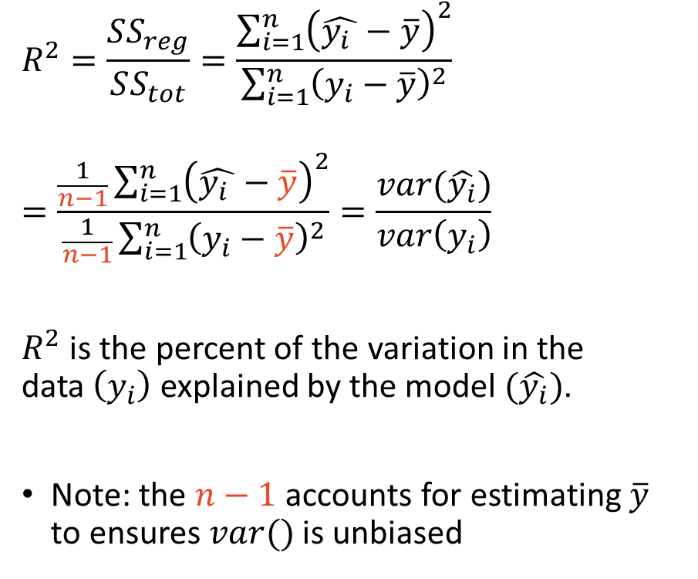
$R^{2}$ explains how well the model fits the data
$$𝕍\left[y\right]=\frac{1}{n−1}\sum_{i=1}^{n}{{\left(y_{i}−\overline{y}\right)}^{2}}$$
“The total variation in $y$”
$$SS_{tot}=\sum_{i=1}^{n}{{\left(y_{i}−\overline{y}\right)}^{2}}$$
$$SS_{reg}=\sum_{i=1}^{n}{{\left(\hat{{y_{i}}_{ }}−\overline{y}\right)}^{2}}$$
$$SS_{res}=\sum_{i=1}^{n}{{\left(y_{i}−{\hat{y_{i}}}_{ }\right)}^{2}}$$
$$R^{2}=\frac{SS_{reg}}{SS_{tot}}=\frac{\sum_{i=1}^{n}{{\left(\hat{{y_{i}}_{ }}−\overline{y}\right)}^{2}}}{\sum_{i=1}^{n}{{\left(y_{i}−\overline{y}\right)}^{2}}}$$
$$=\frac{\frac{1}{n−1}\sum_{i=1}^{n}{{\left(\hat{{y_{i}}_{ }}−\overline{y}\right)}^{2}}}{\frac{1}{n−1}\sum_{i=1}^{n}{{\left(y_{i}−\overline{y}\right)}^{2}}}=\frac{var(\hat{y_{i}})}{var\left(y_{i}\right)}$$
$R^{2}$ is the percent of the variation in the data $\left(y_{i}\right)$ explained by the model $(\hat{y_{i}})$.
Note: the $n−1$ accounts for estimating $\overline{y}$ to ensures $var()$ is unbiased

Slide 20
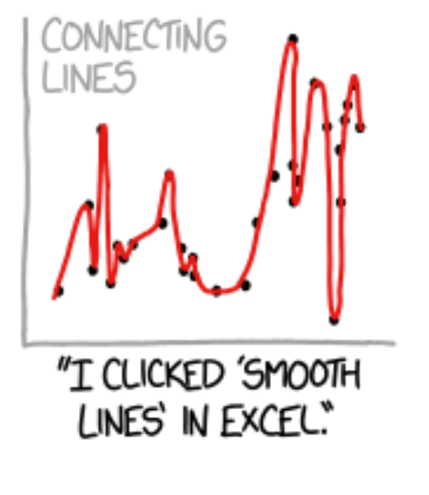
Be careful with $R^{2}=1$…

Slide 21
OLS Practicalities
The things to watch out for

Slide 22
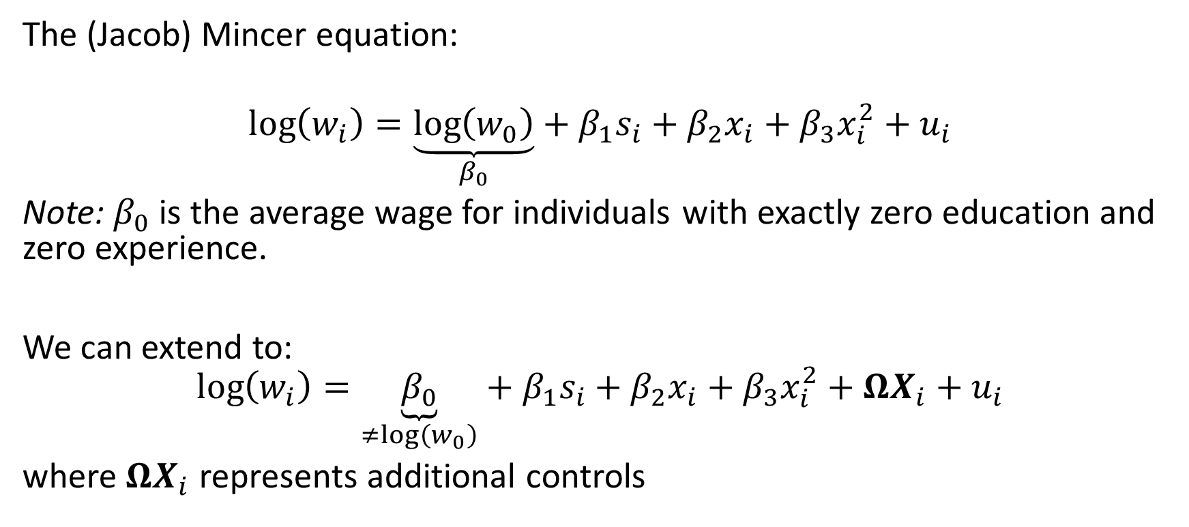
The running (non-causal) example for the lecture
The (Jacob) Mincer equation:
$$\log\left(w_{i}\right)=\underset{β_{0}}{\underbrace{\log\left(w_{0}\right)}}+β_{1}s_{i}+β_{2}x_{i}+β_{3}x_{i}^{2}+u_{i}$$
Note: $β_{0}$ is the average wage for individuals with exactly zero education and zero experience.
We can extend to:
$$\log\left(w_{i}\right)=\underset{≠log\left(w_{0}\right)}{\underbrace{β_{0}}}+β_{1}s_{i}+β_{2}x_{i}+β_{3}x_{i}^{2}+ΩX_{i}+u_{i}$$
where $ΩX_{i}$ represents additional controls

Slide 23
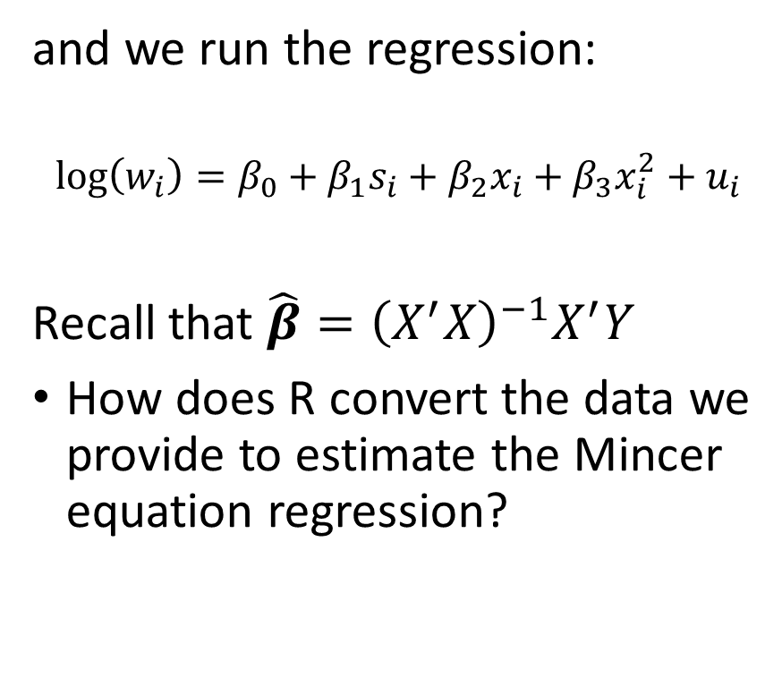
Opening the blackbox of regression
Suppose we collect the data:
hrly_wage yos exp
1: 22.5 14 29
2: 22.5 16 8
3: 22.5 16 29
4: 35.0 12 26
5: 22.5 14 21
6: 29.4 18 22
7: ... ... ...
and we run the regression:
$$\log\left(w_{i}\right)=β_{0}+β_{1}s_{i}+β_{2}x_{i}+β_{3}x_{i}^{2}+u_{i}$$
Recall that $\hat{β}={\left(X^{′}X\right)}^{−1}X^{′}Y$
How does R convert the data we provide to estimate the Mincer equation regression?

Slide 24
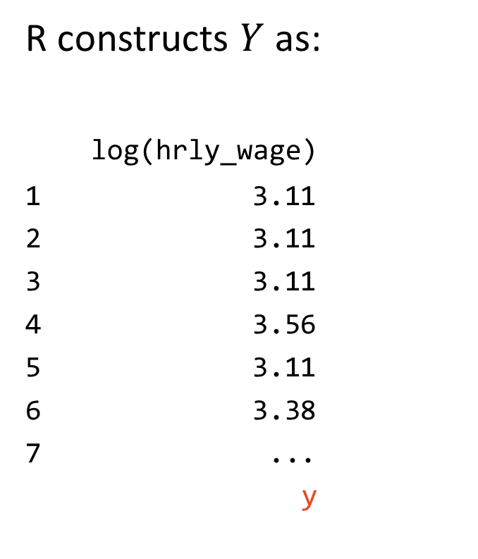
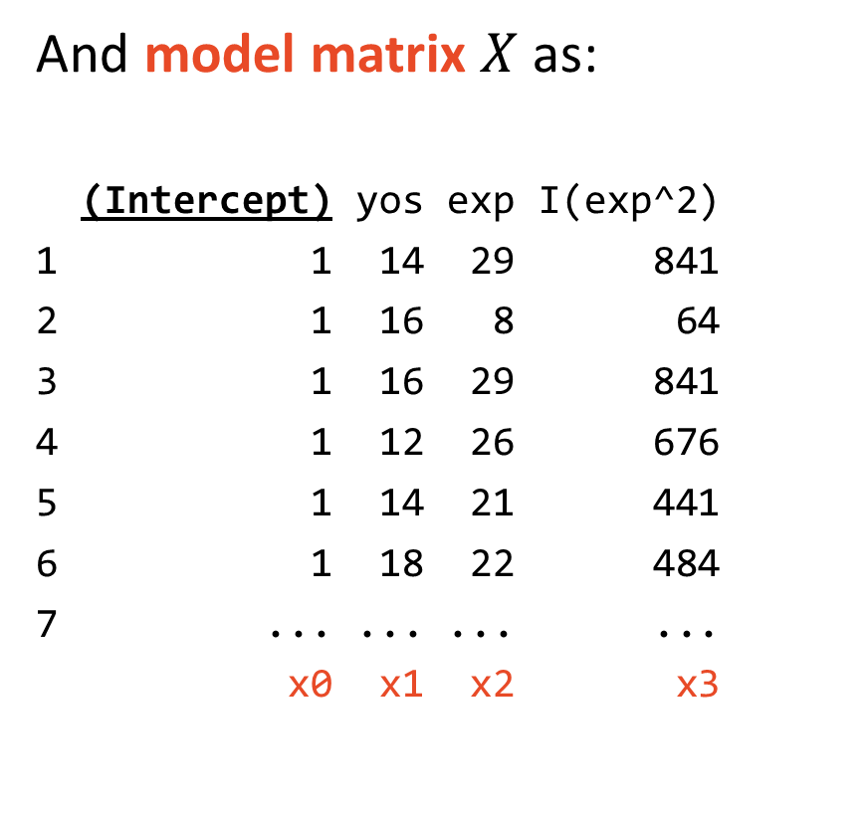
R creates $X$ and $Y$ $\left(\hat{β}={\left(X^{′}X\right)}^{−1}X^{′}Y\right)$ from the data
R constructs $Y$ as:
log(hrly_wage)
1 3.11
2 3.11
3 3.11
4 3.56
5 3.11
6 3.38
7 ...
y
And model matrix $X$ as:
(Intercept) yos exp I(exp^2)
1 1 14 29 841
2 1 16 8 64
3 1 16 29 841
4 1 12 26 676
5 1 14 21 441
6 1 18 22 484
7 ... ... ... ...
x0 x1 x2 x3
$$\log\left(w_{i}\right)=β_{0}+β_{1}s_{i}+β_{2}x_{i}+β_{3}x_{i}^{2}+u_{i}$$

Slide 25
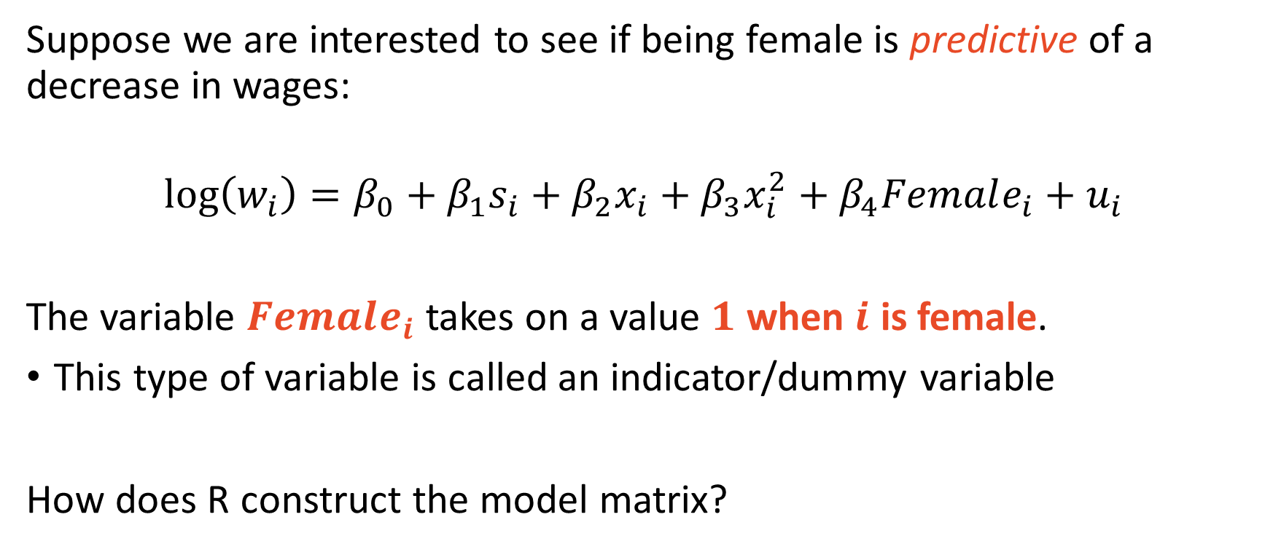
Indicator variables take on values 0 or 1 only (binary)
Suppose we are interested to see if being female is predictive of a decrease in wages:
$$\log\left(w_{i}\right)=β_{0}+β_{1}s_{i}+β_{2}x_{i}+β_{3}x_{i}^{2}+β_{4}Female_{i}+u_{i}$$
The variable $Female_{i}$ takes on a value $1$ when $i$ is female.
This type of variable is called an indicator/dummy variable
How does R construct the model matrix?

Slide 26
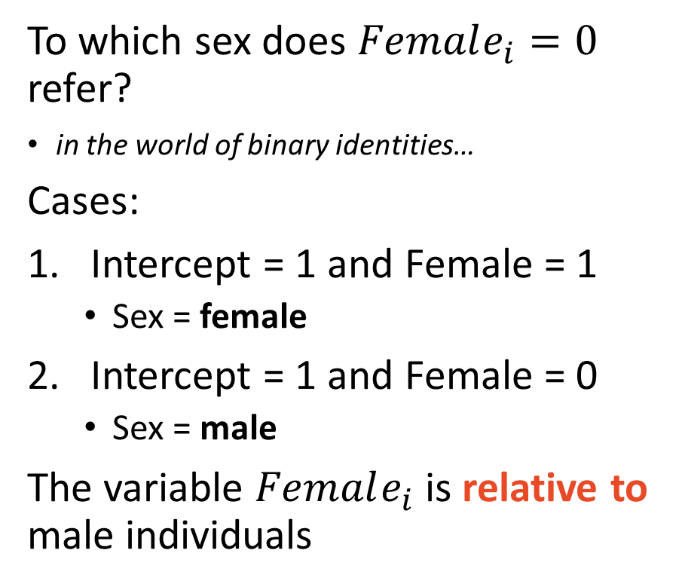
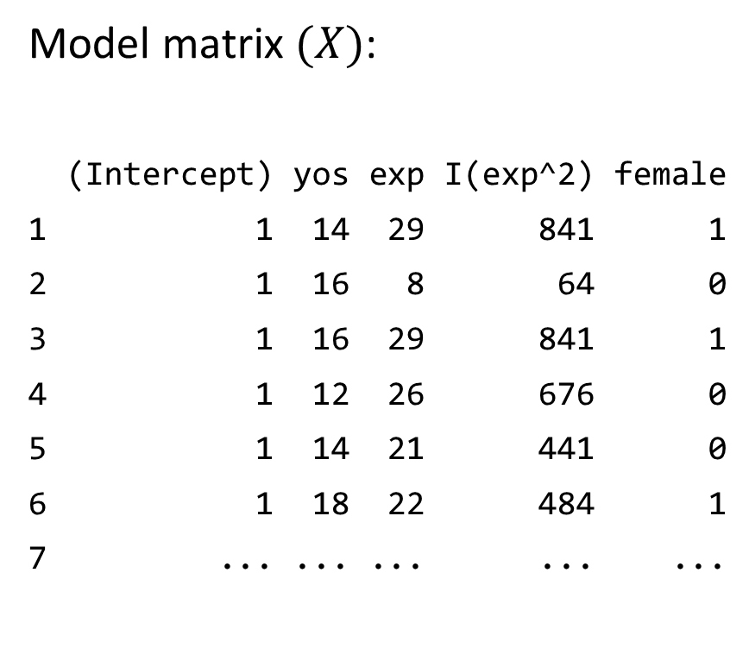
Indicator variables are relative to a baseline
Model matrix $(X)$:
(Intercept) yos exp I(exp^2) female
1 1 14 29 841 1
2 1 16 8 64 0
3 1 16 29 841 1
4 1 12 26 676 0
5 1 14 21 441 0
6 1 18 22 484 1
7 ... ... ... ... ...
To which sex does $Female_{i}=0$ refer?
in the world of binary identities…
Cases:
Intercept = 1 and Female = 1
Sex = female
Intercept = 1 and Female = 0
Sex = male
The variable $Female_{i}$ is relative to male individuals

Slide 27
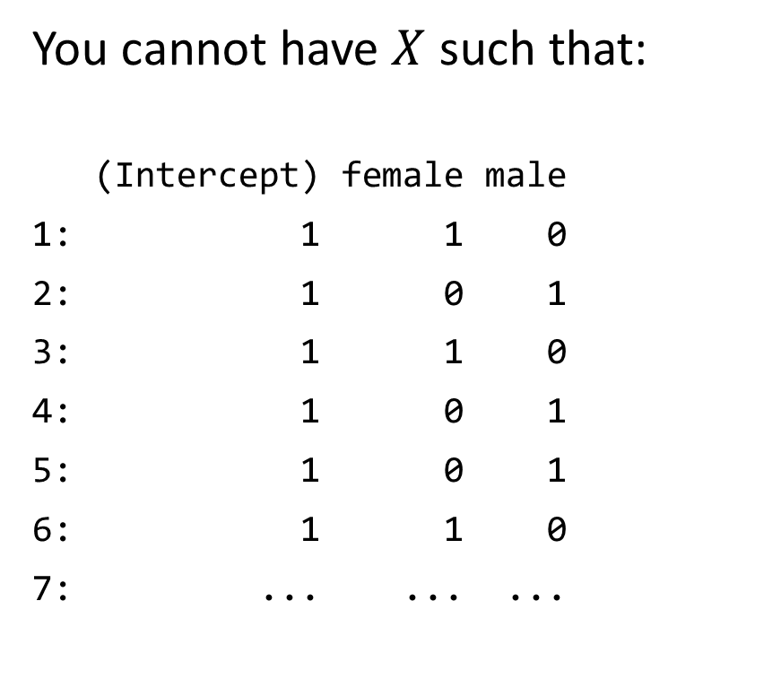
Over saturated models cannot be estimated
You cannot have $X$ such that:
(Intercept) female male
1: 1 1 0
2: 1 0 1
3: 1 1 0
4: 1 0 1
5: 1 0 1
6: 1 1 0
7: ... ... ...
Because
(Intercept) = female + male
This is perfect multicollinearity
Solutions
Remove male
Remove (Intercept)

Slide 28
How to interpret non-causal coefficients
Dependent Var.: log(hrly_wage)
Constant 1.472*** (0.0319)
yos 0.1238*** (0.0013)
exp 0.0144*** (0.0023)
exp^2 -0.0001* (5.2e-5)
female -0.3405*** (0.0076)
_______________ ___________________
R2 0.28528
Observations 27,677
---
Signif. codes: 0 '***' 0.001 '**' 0.01 '*' 0.05 '.' 0.1 ' ' 1
Interpretation of yos:
“One additional year of schooling is associated with a 12% increase in wages.”
Interpretation of female:
“Being female is associated with a 34% decrease in wages relative to the baseline (being male).”
The *** indicates statistical significance from males

Slide 29
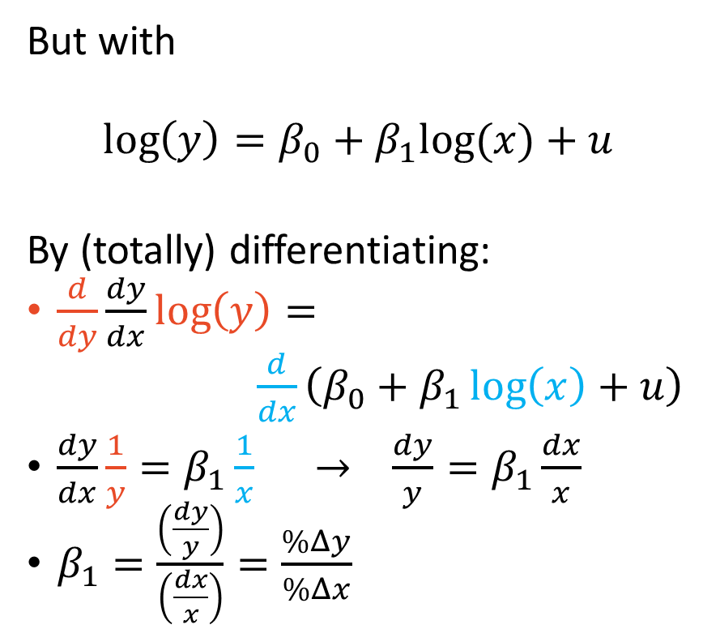
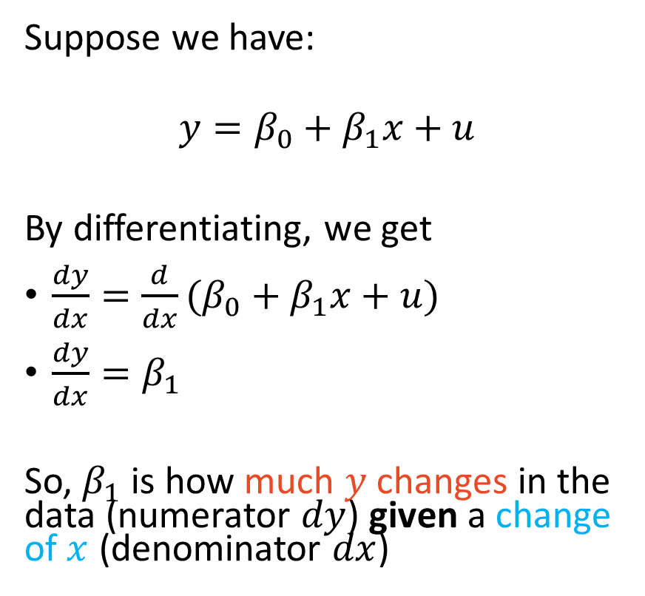
Interpretation of coefficients are from derivatives
Suppose we have:
$$y=β_{0}+β_{1}x+u$$
By differentiating, we get
$\frac{dy}{dx}=\frac{d}{dx}(β_{0}+β_{1}x+u)$
$\frac{dy}{dx}=β_{1}$
So, $β_{1}$ is how much $y$ changes in the data (numerator $dy$) given a change of $x$ (denominator $dx$)
But with
$$\log\left(y\right)=β_{0}+β_{1}log⁡(x)+u$$
By (totally) differentiating:
$\frac{d}{dy}\frac{dy}{dx}\log\left(y\right)=$
$\frac{d}{dx}\left(β_{0}+β_{1}\log\left(x\right)+u\right)$
$\frac{dy}{dx}\frac{1}{y}=β_{1}\frac{1}{x} → \frac{dy}{y}=β_{1}\frac{dx}{x}$
$β_{1}=\frac{\left(\frac{dy}{y}\right)}{\left(\frac{dx}{x}\right)}=\frac{\%Δy}{\%Δx}$

Slide 30
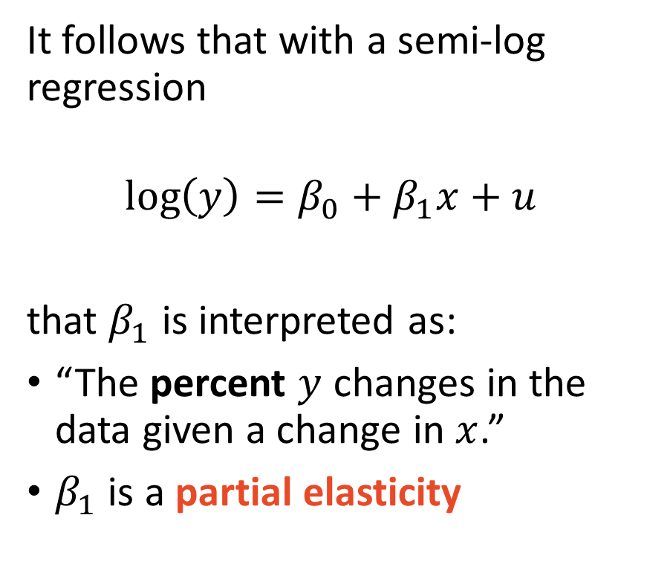
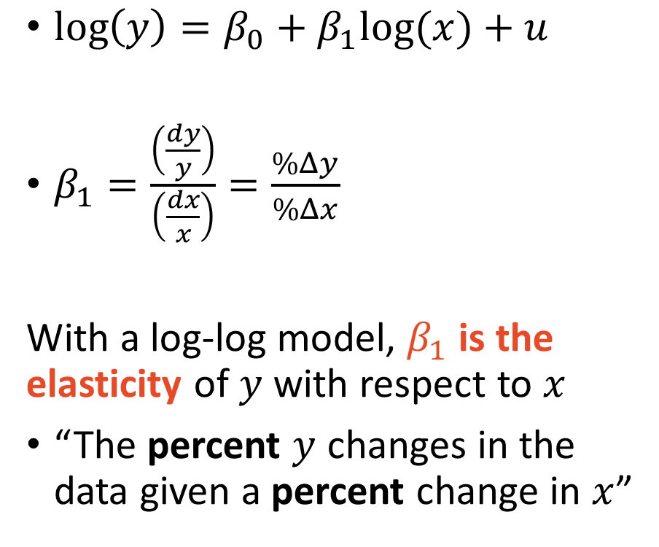
log variables are interpreted as percent change
$\log\left(y\right)=β_{0}+β_{1}log⁡(x)+u$
$β_{1}=\frac{\left(\frac{dy}{y}\right)}{\left(\frac{dx}{x}\right)}=\frac{\%Δy}{\%Δx}$
With a log-log model, $β_{1}$ is the elasticity of $y$ with respect to $x$
“The percent $y$ changes in the data given a percent change in $x$”
It follows that with a semi-log regression
$$\log\left(y\right)=β_{0}+β_{1}x+u$$
that $β_{1}$ is interpreted as:
“The percent $y$ changes in the data given a change in $x$.”
$β_{1}$ is a partial elasticity

Slide 31
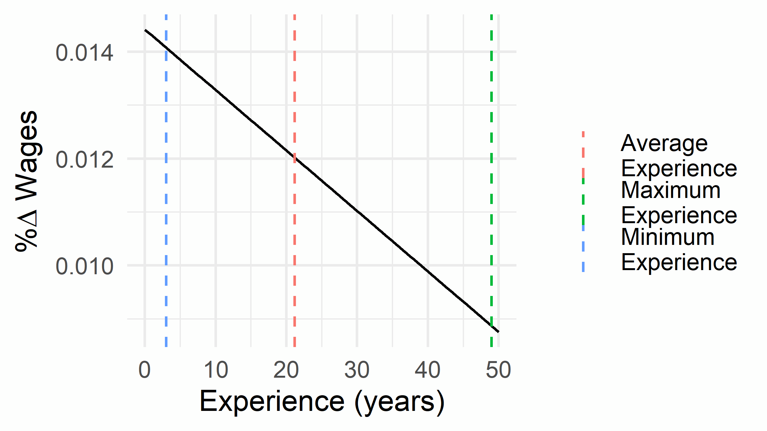
Interpret polynomials at their average value
Dependent Var.: log(hrly_wage)
Constant 1.472*** (0.0319)
yos 0.1238*** (0.0013)
exp 0.0144*** (0.0023)
exp^2 -0.0001* (5.2e-5)
female -0.3405*** (0.0076)
_______________ ___________________
R2 0.28528
Observations 27,677
---
Signif. codes: 0 '***' 0.001 '**' 0.01 '*' 0.05 '.' 0.1 ' ' 1
Interpret squared coefficients at their average value:
“One additional year of experience is associated with a 12% increase in wages at the average level of experience of 21 years.”

Slide 32
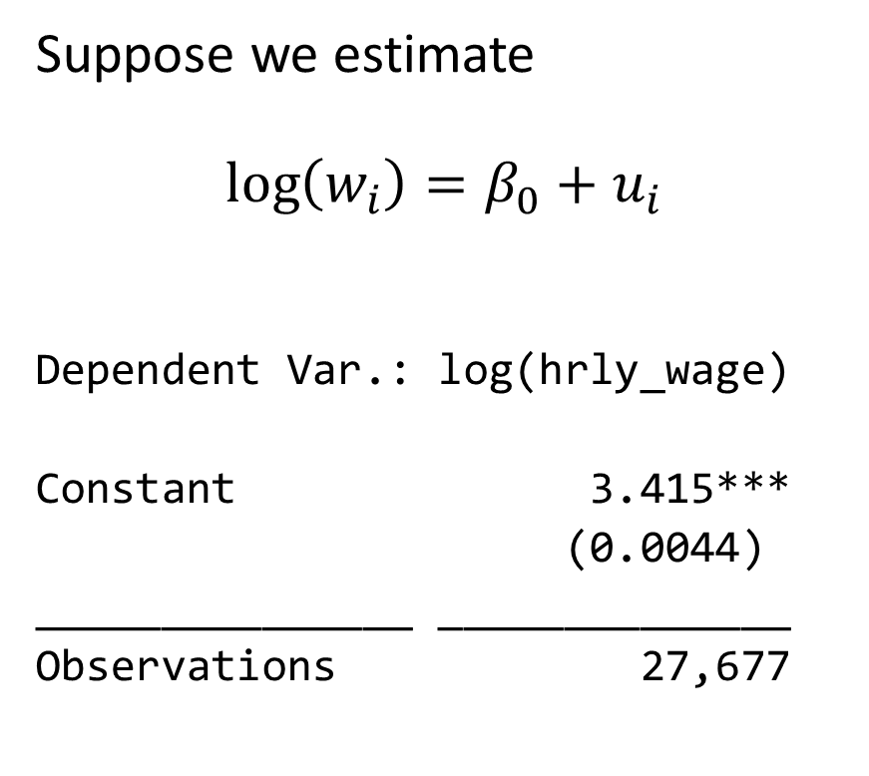
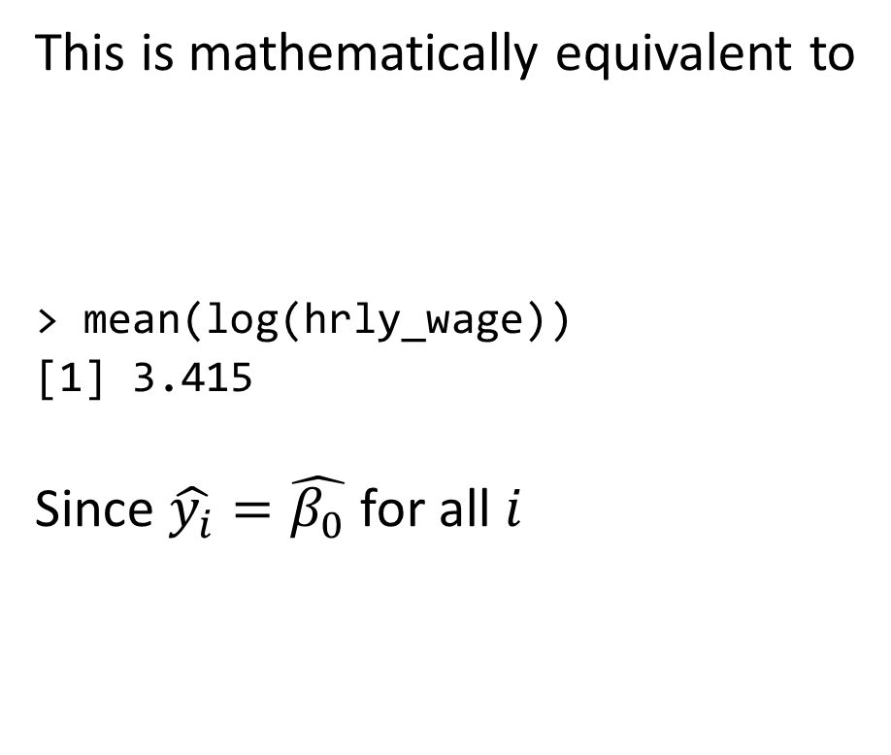
The intercept is the average $y_{i}$ value when all $x_{i}=0$
Suppose we estimate
$$\log\left(w_{i}\right)=β_{0}+u_{i}$$
Dependent Var.: log(hrly_wage)
Constant 3.415***
(0.0044)
_______________ ______________
Observations 27,677
This is mathematically equivalent to
> mean(log(hrly_wage))
[1] 3.415
Since $\hat{y_{i}}=\hat{β_{0}}$ for all $i$

Slide 33
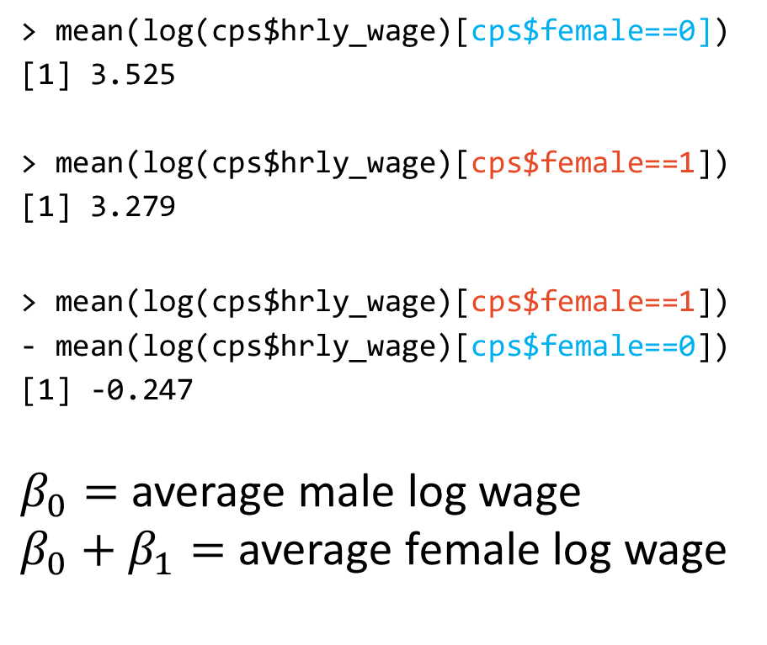
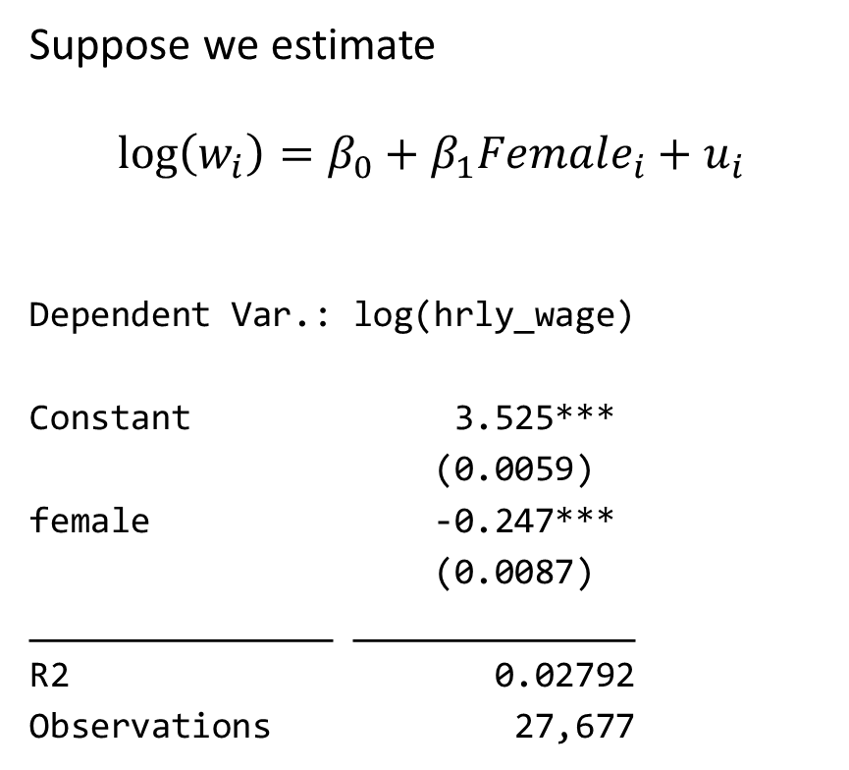
Indicator variables are averages
Suppose we estimate
$$\log\left(w_{i}\right)=β_{0}+β_{1}Female_{i}+u_{i}$$
Dependent Var.: log(hrly_wage)
Constant 3.525***
(0.0059)
female -0.247***
(0.0087)
_______________ ______________
R2 0.02792
Observations 27,677
> mean(log(cps$hrly_wage)[cps$female==0])
[1] 3.525
> mean(log(cps$hrly_wage)[cps$female==1])
[1] 3.279
> mean(log(cps$hrly_wage)[cps$female==1])
- mean(log(cps$hrly_wage)[cps$female==0])
[1] -0.247
$β_{0}=$ average male log wage
$β_{0}+β_{1}=$ average female log wage
ONLY TRUE WITHOUT CONTINUOUS CONTROL VARIABLES!

Slide 34
Indicator variables are (a specific kind of) averages
Dependent Var.: log(hrly_wage)
Constant 3.525***
(0.0059)
female -0.247***
(0.0087)
_______________ ______________
R2 0.02792
Observations 27,677
Dependent Var.: log(hrly_wage)
Constant 1.868***
(0.0177)
female -0.3406***
(0.0076)
yos 0.1138***
(0.0012)
_______________ ______________
R2 0.27612
Observations 27,677

Slide 35
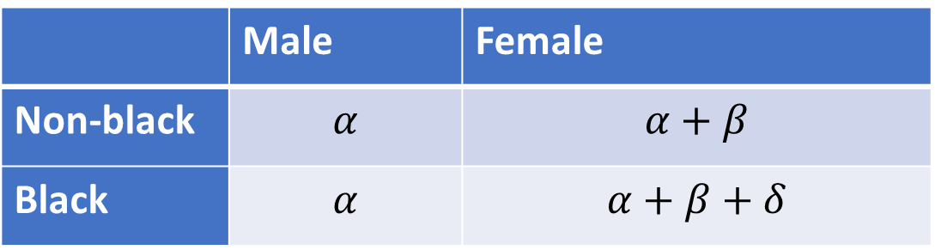
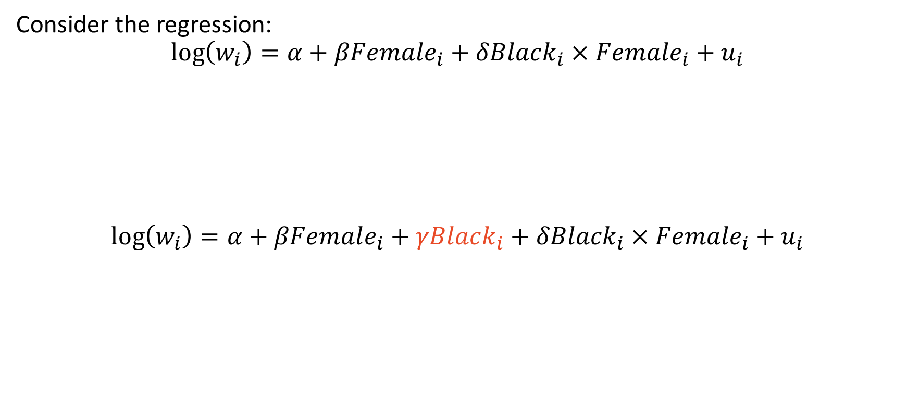
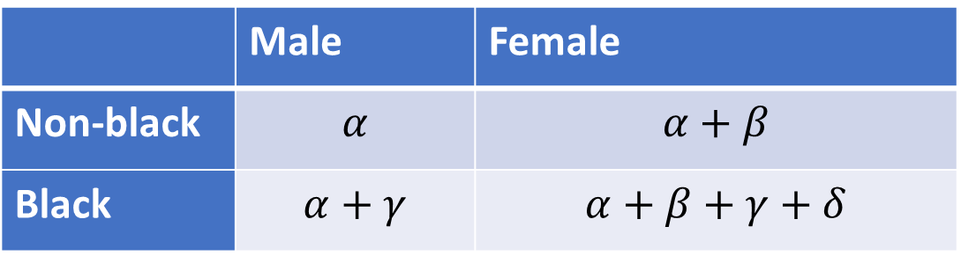
Include all terms if using interactions of variables
Consider the regression:
$$\log\left(w_{i}\right)=α+βFemale_{i}+δBlack_{i}×Female_{i}+u_{i}$$
$$\log\left(w_{i}\right)=α+βFemale_{i}+γBlack_{i}+δBlack_{i}×Female_{i}+u_{i}$$
 | Male | Female
Non-black | $$α$$ | $$α+β$$
Black | $$α$$ | $$α+β+δ$$
 | Male | Female
Non-black | $$α$$ | $$α+β$$
Black | $$α+γ$$ | $$α+β+γ+δ$$
Applies to continuous variables too

Slide 36
OLS Extensions
Correcting standard errors and fixed effects

Slide 37

Standard errors determine if estimate is meaningful
Unbiased coefficient estimates are important for accurately measuring effect effect sizes
The standard errors determines whether your effect sizes are distinguishable from zero
It is, therefore, vital to use the “right” standard errors

Slide 38
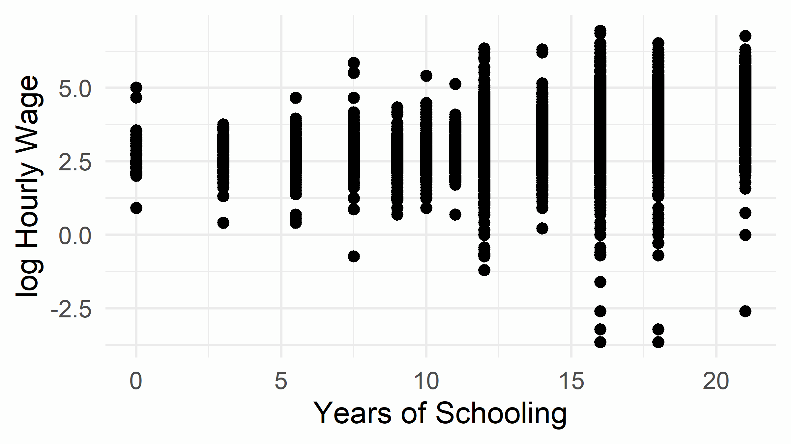
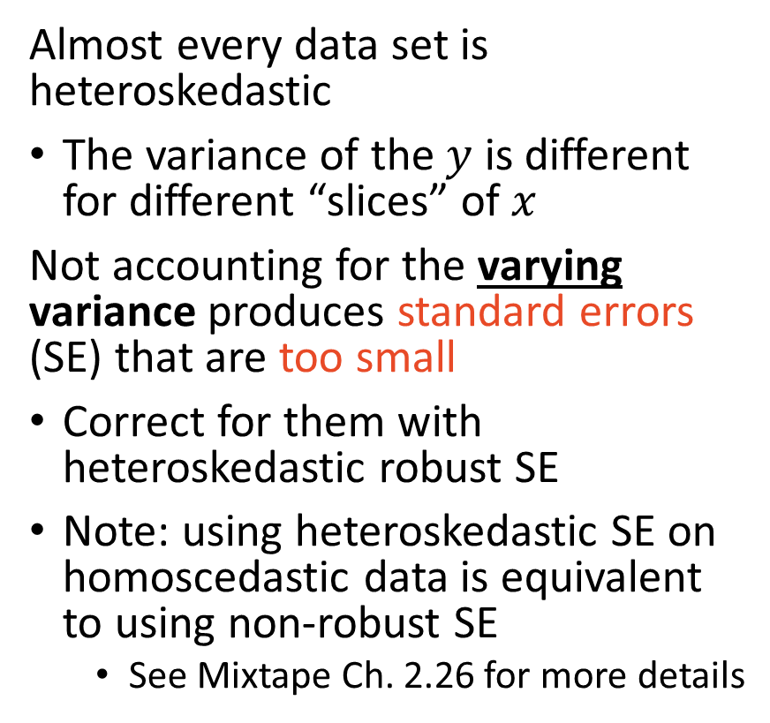
Always use heteroskedastic robust standard errors
Heteroskedasticity:
Almost every data set is heteroskedastic
The variance of the $y$ is different for different “slices” of $x$
Not accounting for the varying variance produces standard errors (SE) that are too small
Correct for them with heteroskedastic robust SE
Note: using heteroskedastic SE on homoscedastic data is equivalent to using non-robust SE
See Mixtape Ch. 2.26 for more details

Slide 39
The treatment level may not match data level
Suppose we are interested in studying the effect of
states expanding lethal self defense laws at different times
We collect a data set of individuals across the 50 states over time (e.g. panel)
Conceptually, the experiment is about individuals, but it is being run at the state level: each state’s policy affects every individual in the state
We need to adjust standard errors by clustering them at the state-level
Additionally, we need fixed-effects to control for state-specific characteristics

Slide 40
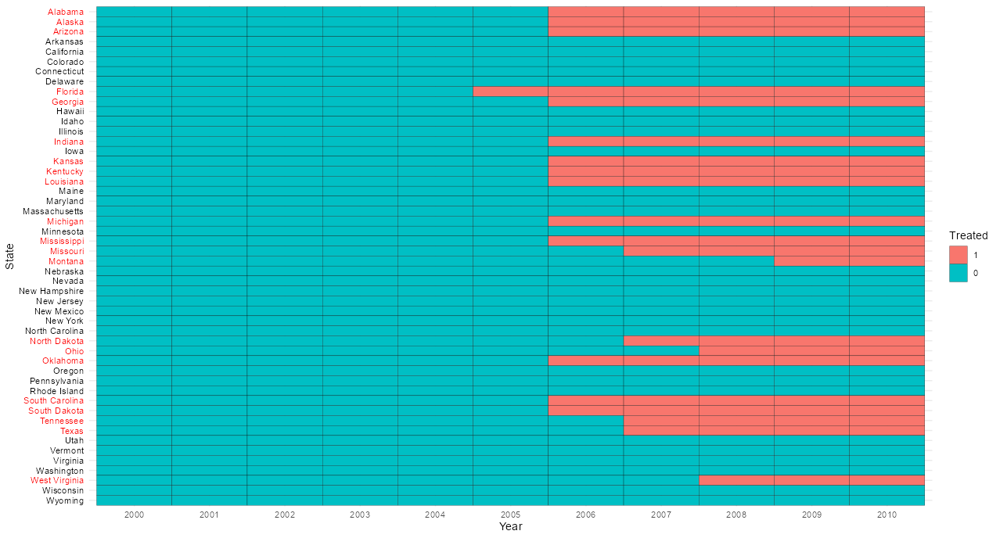

Slide 41
The analysis needs to match the experiment
Clustered standard errors:
An adjustment to ensure standard errors match the variation caused by the experiment (e.g. state)
Clustered standard errors are much smaller than unadjusted SEs
Effectively reducing sample size
See Mixtape Ch. 2.27 for more details
Fixed effects:
Controlling for experiment unit of observation (e.g. state) characteristics that are time-invariant (fixed)
Fixed “effects” is a misnomer; they are not causal effects

Slide 42
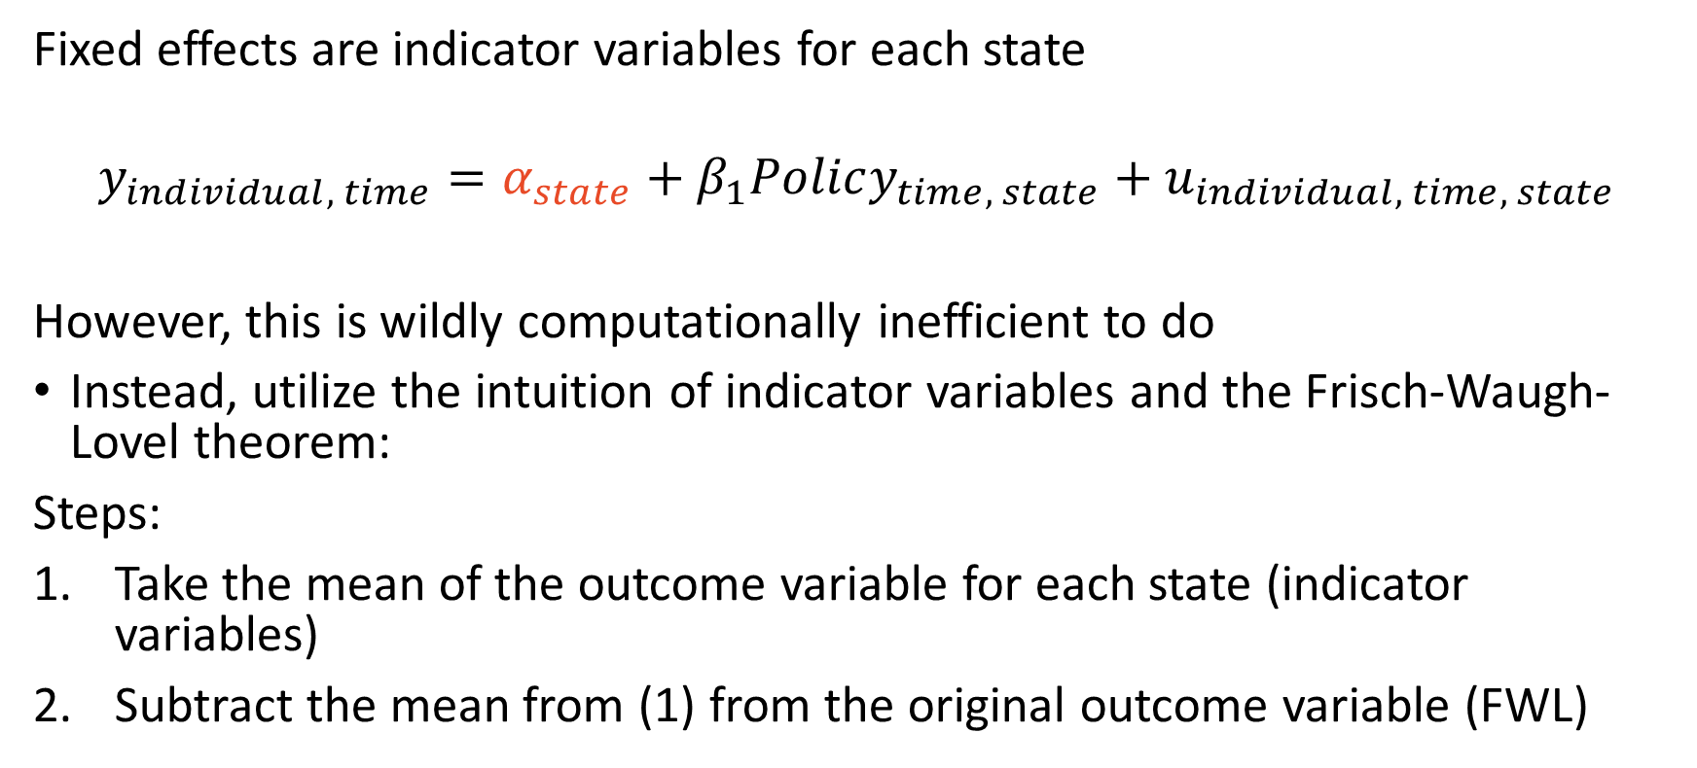
Indicator variables subtract ${\overline{y}}_{group}$ from $y_{i}$
Fixed effects are indicator variables for each state
$$y_{individual, time}=α_{state}+β_{1}Policy_{time, state}+u_{individual, time, state}$$
However, this is wildly computationally inefficient to do
Instead, utilize the intuition of indicator variables and the Frisch-Waugh-Lovel theorem:
Steps:
Take the mean of the outcome variable for each state (indicator variables)
Subtract the mean from (1) from the original outcome variable (FWL)

Slide 43
Today’s coding example
Use Current Population Survey to demonstrate how to:
Run basic regressions in R
Use the fixest package to
Heteroskedastic robust standard errors
Clustered standard errors
Fixed effects

